Slide 1
UNIX MINI-PROJECT ON CLIENT-SERVER ARCHITECTURE
SUBMITTED BY - SUBMITTED TO:-
PRATEEK JAIN (1BM18IS149) Mrs. SHUBHA RAO
ANURAG DHASMANA (1BM18IS014)

Slide 2
ABSTRACT
By the design, a typical Internet service is implemented in two parts—a server that provides information and one or more clients that request information. Such client/server architecture has been gaining popularity as an approach for implementing distributed information systems. The client/server architecture typically consists of a collection of computers connected by a communication network. The functions of the information system are performed by processes (computer programs) that run on these computers and communicate through the network.
In recent years, the client/server architecture has become commonplace as the mechanism that brings the centralized corporate databases to desktop PCs on a network. In a client/server environment, one or more servers manage the centralized database and clients gain access to the server.

Slide 3
INTRODUCTION
The client/server model is an architecture (i.e a system design) that divides processing between clients and servers that can run on the same computer or, more commonly, on different computers on the same network.
It is a major element of modern operating system and network design. A server is a program or the computer on which that program runs, that provides a specific kind of service to clients. A major feature of servers is that they can provide their services to large numbers of clients simultaneously.
The client is usually a program that provides the user interface also referred to as the front end, typically a GUI (graphical user interface), and performs some or all of the processing on requests it makes to the server, which maintains the data and processes the requests.

Slide 4
INTROUCTION ABOUT TCP/IP:-
A TCP (transmission control protocol) is a connection-oriented communication. It is an intermediate layer of the application layer and internet protocol layer in OSI model. TCP is designed to send the data packets over the network. It ensures that data is delivered to the correct destination.
TCP creates a connection between the source and destination node before transmitting the data and keep the connection alive until the communication is active.
In TCP before sending the data it breaks the large data into smaller packets and cares the integrity of the data at the time of reassembling at the destination node. Major Internet applications such as the World Wide Web, email, remote administration, and file transfer rely on TCP.
TCP also offers the facility of retransmission, when a TCP client sends data to the server, it requires an acknowledgment in return. If an acknowledgment is not received, after a certain amount of time transmitted data will be the loss and TCP automatically retransmits the data.
The communication over the network in TCP/IP model takes place in form of a client-server architecture. ie, the client begins the communication and establish a connection with a server.

Slide 5
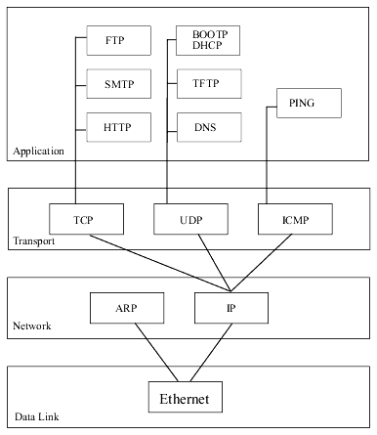
LAYERS IN TCP/IP PROTOCAL
SOCKET PROGRAMMNG: Socket programming is a way of connecting two nodes on a network to communicate with each other. One socket(node) listens on a particular port at an IP, while other socket reaches out to the other to form a connection. Server forms the listener socket while client reaches out to the server.

Slide 6
PROBLEM STATEMENT
In the Client-Server architecture there exists a different leverage of cases for peer to peer communication.
So it is quite difficult to use UDP technique for the connection-less communication and also if we perform the client server communication through internet,it might lead to bottleneck and also high cost for the connection setup.
We need to implement more logic for the peer to peer communication which might be cumbersome.
The only advantage that we can achieve in UDP is that we doesn’t require any dedicated socket(such as specifying the port number).

Slide 7
THE STEPS INVOLVED IN ESTABLISHING A SOCKET ON THE SERVER SIDE ARE AS FOLLOWS:
Create a socket with the socket() system call.
Bind the socket to an address using the bind() system call.
Listen for connections with the listen() system call.
Accept a connection with the accept() system call.
Send and receive data.

Slide 8
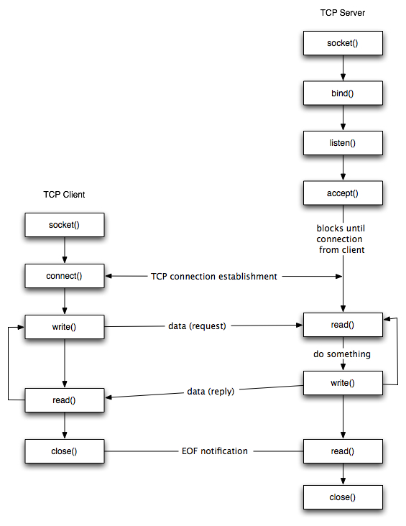
THE DETAILED WORKING OF SYSTEM CALLS:-

Slide 9
ABOUT THE API’s
Socket():-The socket system call creates a new socket by assigning a new descriptor. The new descriptor is returned to the calling process. Any subsequent system calls are identified with the created socket. The socket system call also assigns the protocol to the created socket descriptor.
Bind():-The bind system call associates a local network transport address with a socket. For a client process, it is not mandatory to issue a bind call.
The kernel takes care of doing an implicit binding when the client process issues the connect system call. It is often necessary for a server process
to issue an explicit bind request before it can accept connections or start communication with clients
Connect():-The connect system call is normally called by the client process to connect to the server process. If the client process has not explicitly issued a bind system call before initiating the connection, implicit binding on the local socket is taken care of by the stack..

Slide 10
Listen():-The listen call indicates to the protocol that the server process is ready to accept any new incoming connections on the socket. There is a limit on the number of connections that can be queued up, after which any further connection requests are ignored.
Accept():-The accept system call is a blocking call that waits for incoming connections. Once a connection request is processed, a new socket descriptor is returned by accept. This new socket is connected to the client and the other socket s remains in LISTEN state to accept further connections.
Write():- A successful write() updates the change and modification times for the file. If fs refers to a socket, write() is equivalent to send() with no flags set. Behavior for sockets: The write() function writes data from a buffer on a socket with descriptor fs. The socket must be a connected socket.
Read():-The read() call reads data on a socket with descriptor fs and stores it in a buffer. The read() all applies only to connected sockets. This call returns up to N bytes of data. If there are fewer bytes available than requested, the call returns the number currently available.
Close:-The close function shuts down the socket associated with socket descriptor s, and frees resources allocated to the socket. If s refers to an open TCP connection, the connection is closed.

Slide 11
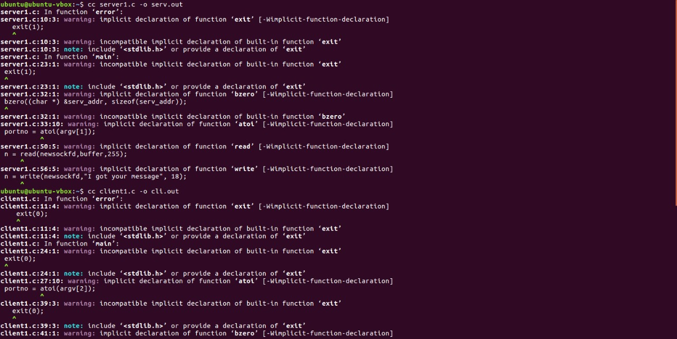
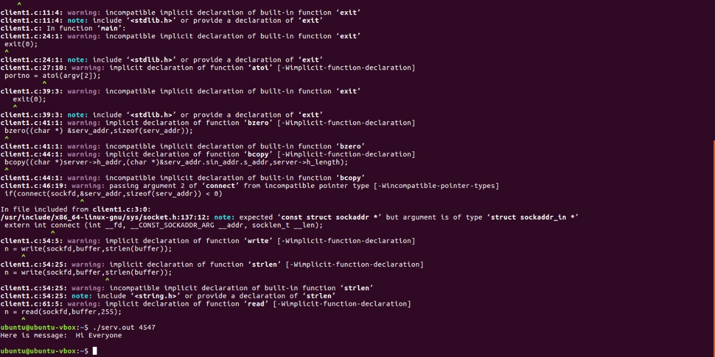
OUTPUT/SNAPSHOTS:-

Slide 12
CONCLUSION
The main goal of this project is to develop a client server architecture which is done by using tcp/ip network model and also socket programming concept by which the peer to peer communication takes place by programming a port (such as specifying the port with a dedicated number)
It might be useful in saving the high cost for the connection setup such as UDP protocal and also it will not be cumbersome to develop a socket programming as it is easy and well designated steps by using some services is API’s.

